Slide 1
Sequential Circuits
Asynchronous
Synchronous
Combinational
Circuit
Inputs
Outputs
Memory
Elements
Combinational
Circuit
Inputs
Outputs
Flip-flops
Clock
<number> / 60
Notes:
Princess Sumaya University
4241 - Digital Logic Design
Dr. Bassam Kahhaleh

Slide 2
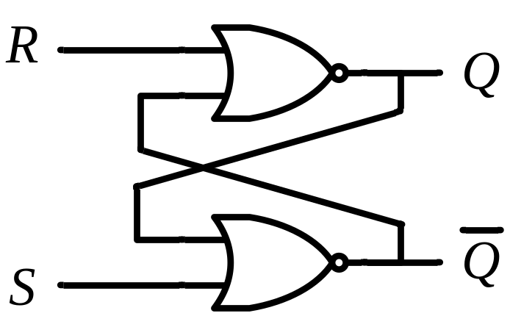
Latches
SR Latch
S R Q₀ | Q | Q’
0 0 0
0 | 1
Q = Q₀
0
0
0
1
Initial Value
<number> / 60

Slide 3
Latches
SR Latch
S R Q₀ | Q | Q’
0 0 0 | 0 | 1
0 0 1
Q = Q₀
1 | 0
Q = Q₀
0
1
0
0
<number> / 60

Slide 4
Latches
SR Latch
S R Q₀ | Q | Q’
0 0 0 | 0 | 1
0 0 1 | 1 | 0
0 1 0 | 0
Q = Q₀
1
 | 1
Q = 0
0
0
1
<number> / 60

Slide 5
Latches
SR Latch
S R Q₀ | Q | Q’
0 0 0 | 0 | 1
0 0 1 | 1 | 0
0 1 0 | 0 | 1
0 1 1
Q = Q₀
1
Q = 0
1
0 | 1
Q = 0
0
0
<number> / 60

Slide 6
Latches
SR Latch
S R Q₀ | Q | Q’
0 0 0 | 0 | 1
0 0 1 | 1 | 0
0 1 0 | 0 | 1
0 1 1 | 0 | 1
1 0 0
Q = Q₀
0
0
Q = 0
1 | 0
Q = 1
1
1
<number> / 60

Slide 7
Latches
SR Latch
S R Q₀ | Q | Q’
0 0 0 | 0 | 1
0 0 1 | 1 | 0
0 1 0 | 0 | 1
0 1 1 | 0 | 1
1 0 0 | 1 | 0
1 0 1
Q = Q₀
0
1
Q = 0
Q = 1
1 | 0
Q = 1
1
0
<number> / 60

Slide 8
Latches
SR Latch
S R Q₀ | Q | Q’
0 0 0 | 0 | 1
0 0 1 | 1 | 0
0 1 0 | 0 | 1
0 1 1 | 0 | 1
1 0 0 | 1 | 0
1 0 1 | 1 | 0
1 1 0
Q = Q₀
1
0
Q = 0
Q = 1
0 | 0
Q = Q’
1
1
0
<number> / 60

Slide 9
Latches
SR Latch
S R Q₀ | Q | Q’
0 0 0 | 0 | 1
0 0 1 | 1 | 0
0 1 0 | 0 | 1
0 1 1 | 0 | 1
1 0 0 | 1 | 0
1 0 1 | 1 | 0
1 1 0 | 0 | 0
1 1 1
Q = Q₀
1
1
Q = 0
0
Q = 1
Q = Q’
0 | 0
Q = Q’
1
0
<number> / 60

Slide 10
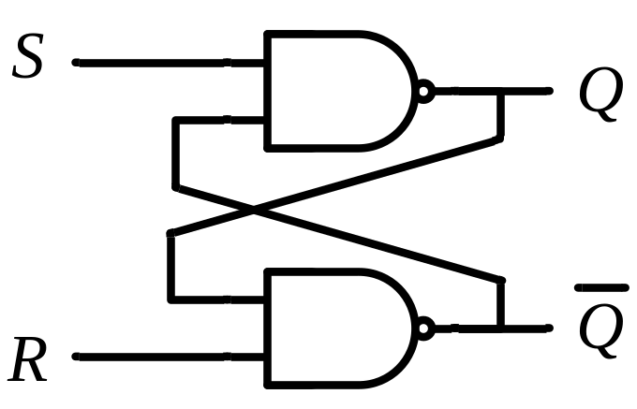
Latches
SR Latch
S R | Q
0 0 | Q₀
0 1 | 0
1 0 | 1
1 1 | Q=Q’=0
No change
Reset
Set
Invalid
S R | Q
0 0 | Q=Q’=1
0 1 | 1
1 0 | 0
1 1 | Q₀
Invalid
Set
Reset
No change
<number> / 60

Slide 11
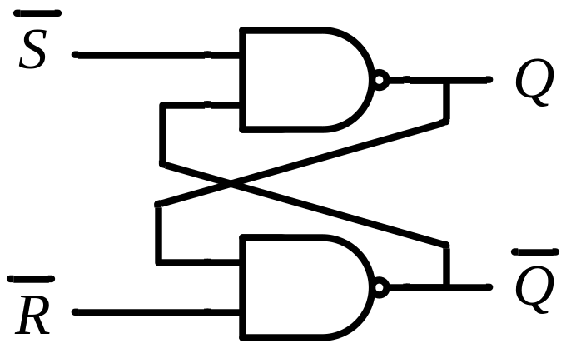
Latches
SR Latch
S R | Q
0 0 | Q₀
0 1 | 0
1 0 | 1
1 1 | Q=Q’=0
No change
Reset
Set
Invalid
S’ R’ | Q
0 0 | Q=Q’=1
0 1 | 1
1 0 | 0
1 1 | Q₀
Invalid
Set
Reset
No change
<number> / 60

Slide 12
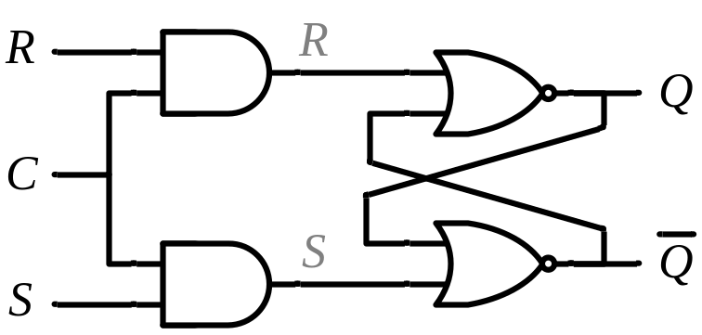
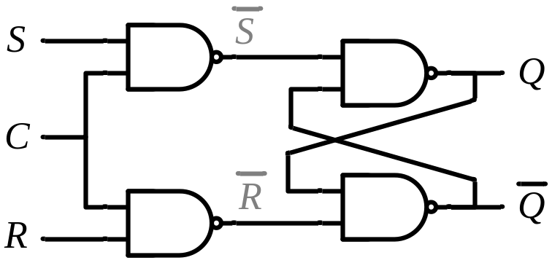
Controlled Latches
SR Latch with Control Input
C S R | Q
0 x x | Q₀
1 0 0 | Q₀
1 0 1 | 0
1 1 0 | 1
1 1 1 | Q=Q’
No change
No change
Reset
Set
Invalid
<number> / 60

Slide 13
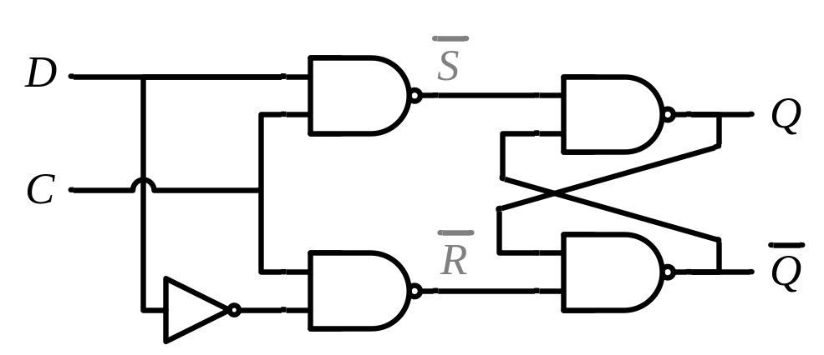
Controlled Latches
D Latch (D = Data)
Timing Diagram
C
D
Q
t
C D | Q
0 x | Q₀
1 0 | 0
1 1 | 1
Output may change
No change
Reset
Set
<number> / 60

Slide 14
Controlled Latches
D Latch (D = Data)
Timing Diagram
C
D
Q
C D | Q
0 x | Q₀
1 0 | 0
1 1 | 1
Output may change
No change
Reset
Set
<number> / 60

Slide 15
Flip-Flops
Controlled latches are level-triggered
Flip-Flops are edge-triggered
C
CLK
Positive Edge
CLK
Negative Edge
<number> / 60

Slide 16

Flip-Flops
Master-Slave D Flip-Flop
D Latch
(Master)
D Latch
(Slave)
D
D
C
Q
D
C
Q
Q
Master
Slave
CLK
CLK
D
Looks like it is negative edge-triggered
Q_{Master}
Q_{Slave}
<number> / 60

Slide 17
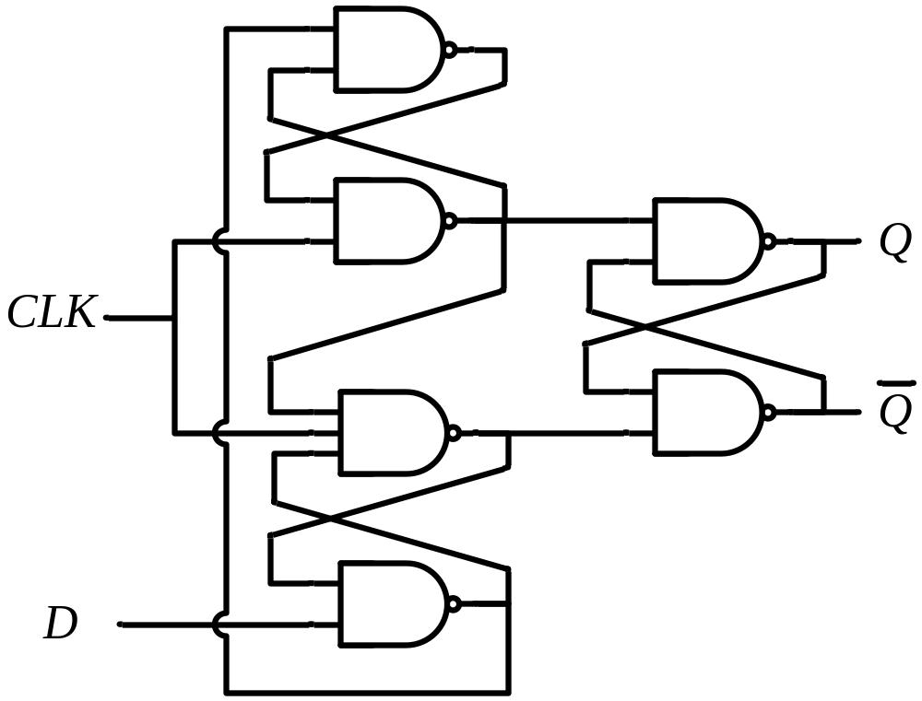
Flip-Flops
Edge-Triggered D Flip-Flop
D
Q
Q
Positive Edge
D
Q
Q
Negative Edge
<number> / 60

Slide 18
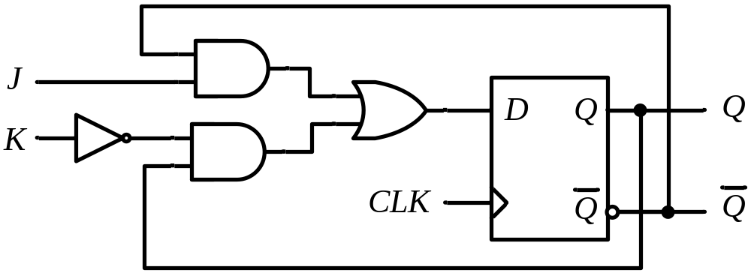
Flip-Flops
JK Flip-Flop
J
Q
D = JQ’ + K’Q
K
Q
<number> / 60

Slide 19

Flip-Flops
T Flip-Flop
T
J
Q
T
D
Q
Q
K
Q
T
Q
D = JQ’ + K’Q
D = TQ’ + T’Q = T ⊕ Q
Q
<number> / 60

Slide 20
Flip-Flop Characteristic Tables
D | Q(t+1)
0 | 0
1 | 1
D
Q
Reset
Set
Q
J | K | Q(t+1)
0 | 0 | Q(t)
0 | 1 | 0
1 | 0 | 1
1 | 1 | Q’(t)
J
Q
No change
Reset
Set
Toggle
K
Q
T
Q
T | Q(t+1)
0 | Q(t)
1 | Q’(t)
No change
Toggle
Q
<number> / 60

Slide 21
Flip-Flop Characteristic Equations
D | Q(t+1)
0 | 0
1 | 1
D
Q
Q(t+1) = D
Q
J | K | Q(t+1)
0 | 0 | Q(t)
0 | 1 | 0
1 | 0 | 1
1 | 1 | Q’(t)
J
Q
Q(t+1) = JQ’ + K’Q
K
Q
T
Q
T | Q(t+1)
0 | Q(t)
1 | Q’(t)
Q(t+1) = T ⊕ Q
Q
<number> / 60

Slide 22
Flip-Flop Characteristic Equations
Analysis / Derivation
J | K | Q(t) | Q(t+1)
0 | 0 | 0 | 0
0 | 0 | 1 | 1
0 | 1 | 0
0 | 1 | 1
1 | 0 | 0
1 | 0 | 1
1 | 1 | 0
1 | 1 | 1
No change
Reset
Set
Toggle
J
Q
K
Q
<number> / 60

Slide 23
Flip-Flop Characteristic Equations
Analysis / Derivation
J | K | Q(t) | Q(t+1)
0 | 0 | 0 | 0
0 | 0 | 1 | 1
0 | 1 | 0 | 0
0 | 1 | 1 | 0
1 | 0 | 0
1 | 0 | 1
1 | 1 | 0
1 | 1 | 1
No change
Reset
Set
Toggle
J
Q
K
Q
<number> / 60

Slide 24
Flip-Flop Characteristic Equations
Analysis / Derivation
J | K | Q(t) | Q(t+1)
0 | 0 | 0 | 0
0 | 0 | 1 | 1
0 | 1 | 0 | 0
0 | 1 | 1 | 0
1 | 0 | 0 | 1
1 | 0 | 1 | 1
1 | 1 | 0
1 | 1 | 1
No change
Reset
Set
Toggle
J
Q
K
Q
<number> / 60

Slide 25
Flip-Flop Characteristic Equations
Analysis / Derivation
J | K | Q(t) | Q(t+1)
0 | 0 | 0 | 0
0 | 0 | 1 | 1
0 | 1 | 0 | 0
0 | 1 | 1 | 0
1 | 0 | 0 | 1
1 | 0 | 1 | 1
1 | 1 | 0 | 1
1 | 1 | 1 | 0
No change
Reset
Set
Toggle
J
Q
K
Q
<number> / 60

Slide 26
Flip-Flop Characteristic Equations
Analysis / Derivation
J | K | Q(t) | Q(t+1)
0 | 0 | 0 | 0
0 | 0 | 1 | 1
0 | 1 | 0 | 0
0 | 1 | 1 | 0
1 | 0 | 0 | 1
1 | 0 | 1 | 1
1 | 1 | 0 | 1
1 | 1 | 1 | 0
J
Q
 |  |  |  | K
 |  | 0 | 1 | 0 | 0
J |  | 1 | 1 | 0 | 1
 |  |  | Q
K
Q
Q(t+1) = JQ’ + K’Q
<number> / 60

Slide 27
Flip-Flops with Direct Inputs
Asynchronous Reset
R’ | D | CLK | Q(t+1)
0 | x | x | 0
D
Q
Q
R
Reset
<number> / 60

Slide 28
Flip-Flops with Direct Inputs
Asynchronous Reset
R’ | D | CLK | Q(t+1)
0 | x | x | 0
1 | 0 | ↑ | 0
1 | 1 | ↑ | 1
D
Q
Q
R
Reset
<number> / 60

Slide 29
Flip-Flops with Direct Inputs
Asynchronous Preset and Clear
Preset
PR’ | CLR’ | D | CLK | Q(t+1)
1 | 0 | x | x | 0
PR
D
Q
Q
CLR
Reset
<number> / 60

Slide 30
Flip-Flops with Direct Inputs
Asynchronous Preset and Clear
Preset
PR’ | CLR’ | D | CLK | Q(t+1)
1 | 0 | x | x | 0
0 | 1 | x | x | 1
PR
D
Q
Q
CLR
Reset
<number> / 60

Slide 31
Flip-Flops with Direct Inputs
Asynchronous Preset and Clear
Preset
PR’ | CLR’ | D | CLK | Q(t+1)
1 | 0 | x | x | 0
0 | 1 | x | x | 1
1 | 1 | 0 | ↑ | 0
1 | 1 | 1 | ↑ | 1
PR
D
Q
Q
CLR
Reset
<number> / 60

